Slide 1
Week 8 – Motivation
第8周 – 动力

Slide 2
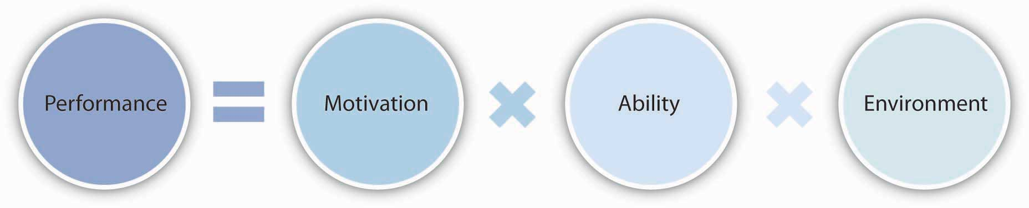
Factors influencing individual performance影响个人绩效的因素
绩效
动力
能力
环境
Notes:
Study questions:
What is motivation?
What are the different types of individual needs?
What are the process theories of motivation and why is self-efficacy so important?
What role does reinforcement play in motivation?
What are the trends in motivation and remuneration?

Slide 3
What is motivation?
什么是动力？
Motivation
  Forces within the individual that account for the level, direction and persistence of effort expended at work.
Intrinsic motivation
Extrinsic motivation
动力
个人内部的力量，解释了在工作中花费的努力水平、方向和持久性。
内在动力
外在动力
Notes:
Productivity through people is an essential ingredient of long-term organisational success.
Motivation - forces within the individual that account for the level, direction and persistence of effort expended at work.
A highly motivated workforce is indispensable to the achievement of sustained high-performance results.
A reward is a work outcome of positive value to the individual, it is useful to distinguish between two types of rewards, extrinsic and intrinsic. Extrinsic rewards are externally administered, the motivational stimulus of extrinsic rewards originates outside of the individual. They are valued outcomes given to someone by another person, examples are pay bonuses, promotions, time off, and special assignments.
Intrinsic rewards are self-administered. They occur ‘naturally’ as a person performs a task and are built directly into the job itself. The major sources of intrinsic rewards are the feelings of competency, personal development and self control people experience in their work. In contrast to extrinsic rewards, the motivational stimulus of intrinsic rewards is internal and does not depend on the actions of some other person.
Rewards and performance
Effectively linking rewards and performance is easier said than done. Human beings possess individual desires, needs, and dreams.
Managers must respect diversity and individual differences, clearly understand what people want from work and allocate rewards to satisfy the interests of both individuals and the organisation.

Slide 4
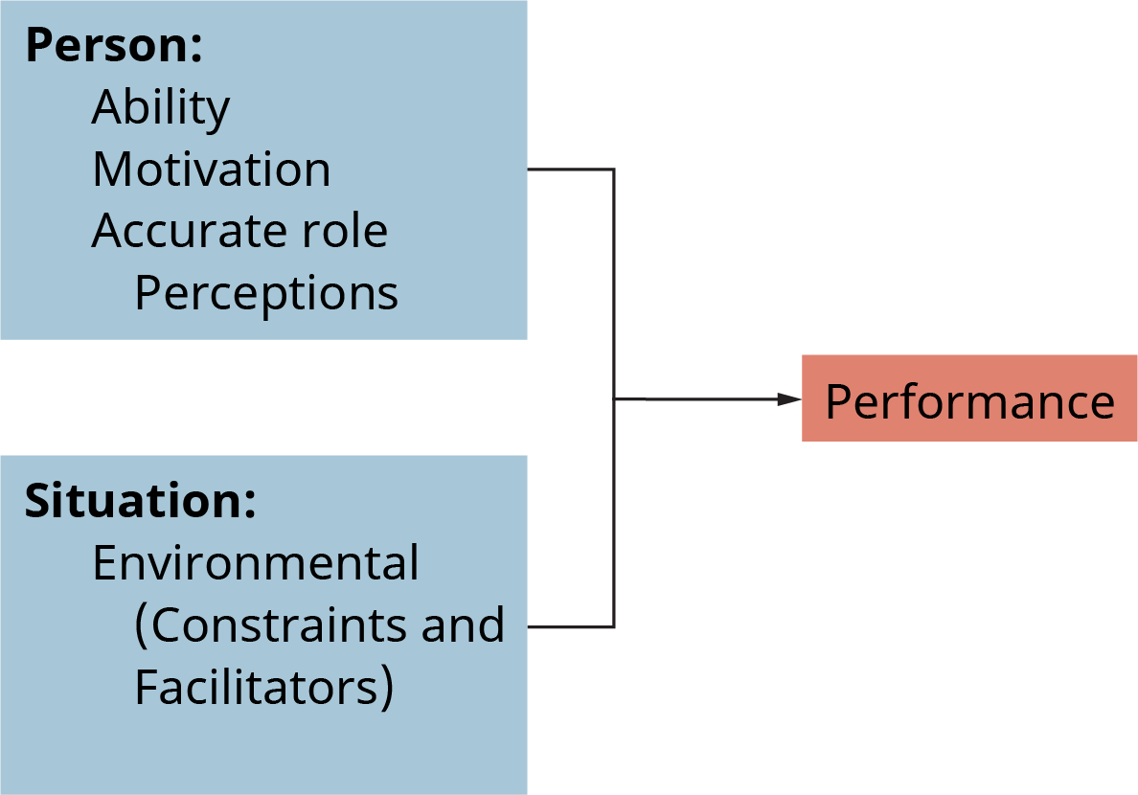
Main components of performance绩效的主要组成部分
个人因素（Person）：
能力（Ability）
动机（Motivation）
对角色的准确认知（Accurate role Perceptions）
情境因素（Situation）：
- 环境因素（包括制约因素和促进因素）[Environmental (Constraints and Facilitators)]

Slide 5
Theories of motivation 动力理论
Content theories of motivation
  based on an understanding of human needs and how people with different needs may respond to different work situations
Process theories of motivation
  based on an understanding of how people give meaning to rewards and then respond with various work-related behaviours
Reinforcement theories of motivation
  based on the premise that behaviour is largely based on consequences
动力的内容理论
基于对人类需求的理解，以及具有不同需求的人如何应对不同的工作情况
动力的过程理论
基于对人们如何赋予奖励意义，然后以各种与工作相关的行为做出反应的理解
动力的强化理论
基于行为在很大程度上基于后果的前提
Notes:
The content theories of motivation help us to understand human needs and how people with different needs may respond to different work situations.
The process theories of motivation offer additional insights into how people give meaning to rewards and then respond with various work-related behaviours.
The reinforcement theory of motivation focuses attention on the environment as a major source of rewards and influence on human behaviour.

Slide 6
Content theories of motivation动力的内容理论
Needs
  The unfulfilled physiological or psychological desires of an individual.
All people have needs. They engage in behaviours to obtain extrinsic and intrinsic rewards to satisfy these needs.
Needs cause tensions that influence attitudes and behaviours.
需要
个人未满足的生理或心理欲望。
每个人都有需求。他们参与行为以获得外在和内在的奖励来满足这些需求。
需求会导致紧张关系，从而影响态度和行为。
Notes:
Most discussions of motivation begin with the concept of individual needs — the unfulfilled physiological or psychological desires of an individual. Content theories of motivation use individual needs to explain the behaviours and attitudes of people at work.
People have needs. They engage in behaviours to obtain extrinsic and intrinsic rewards to satisfy these needs.
Needs cause tensions that influence attitudes and behaviours. Good managers and leaders establish conditions in which people are able to satisfy important needs through their work.

Slide 7
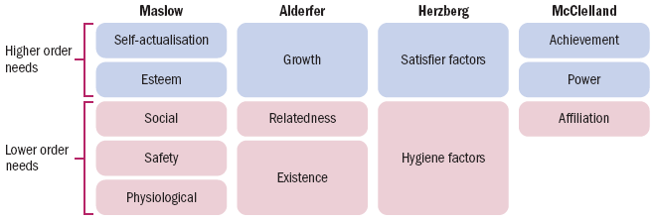
Overview of theories within the content perspective
内容视角下的理论概述
 | 马斯洛 | 奥尔德弗 | 赫茨伯格 | 麦克利兰
高层次需求 | 自我实现 尊重 | 成长 | 激励因素 | 成就 权力
低层次需求 | 社交 安全 生理 | 关系 生存 | 保健因素 | 归属
Notes:
This figure shows how the human needs identified by Maslow, Alderfer, Herzberg and McClelland compare with one another.
Also note that work outcomes or rewards can satisfy more than one need. Human needs operate in a flexible hierarchy, and people may also value needs differently at different times and at different ages or career stages.

Slide 8
Maslow’s hierarchy of needs theory马斯洛需求层次理论
Lower order needs: Physiological, safety and social concerns.
Higher order needs: Esteem and self-actualisation concerns.
The deficit principle states that a satisfied need is not a motivator. People are expected to act in ways that satisfy deprived needs.
The progression principle states that a need at one level does not become activated until the next need is already satisfied. People advance through the hierarchy step-by-step.
低阶需求：生理、安全和社会问题。
高阶需求：尊重和自我实现问题。
赤字原则指出，满足的需求不是动力。人们被期望以满足被剥夺需求的方式行事。
进展原则指出，一个层次的需求在下一个需求得到满足之前不会被激活。人们在等级制度中逐步前进。
Notes:
Hierarchy of needs theory
According to Maslow’s hierarchy of human needs, lower order needs are physiological, safety and social concerns, and higher order needs are esteem and self-actualisation concerns.
The deficit principle states that a satisfied need is not a motivator of behaviour. People are expected to act in ways that satisfy deprived needs.
The progression principle states that a need at one level does not become activated until the next lower level need is already satisfied. People are expected to advance step-by-step.
Maslow’s theory advises managers to recognise that deprived needs may negatively influence attitudes and behaviours. By the same token, providing opportunities for need satisfaction may have positive motivational consequences.
Higher order self-actualisation needs are served entirely by intrinsic rewards. The esteem needs are served by both intrinsic and extrinsic rewards. Lower order needs are served solely by extrinsic rewards.

Slide 9
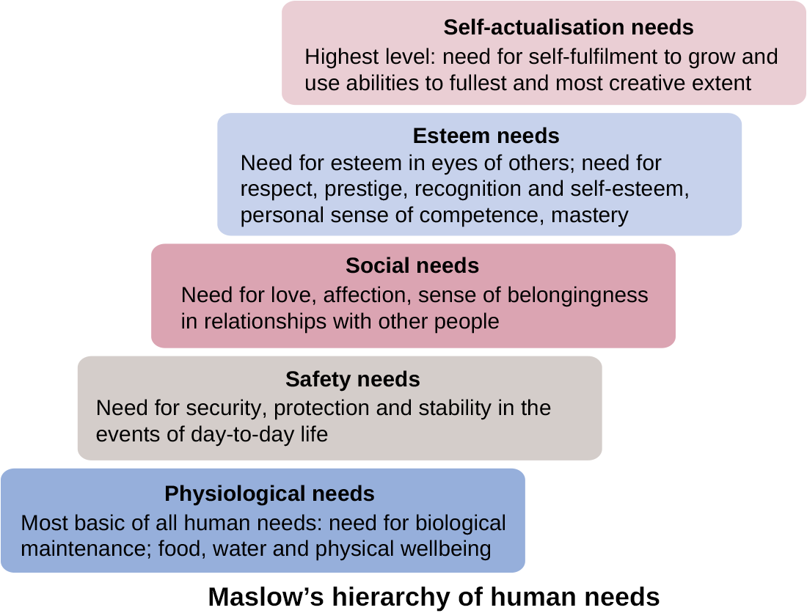
自我实现需求
最高层次需求：自我实现的需求，即最大限度且最具创造性地成长和发挥自身能力。
尊重需求
需要在他人眼中获得尊重，对尊重、威望、认可的需求，以及自尊、个人的能力掌控感。
社交需求
在人际关系中对爱、情感和归属感的需求。
安全需求
在日常生活中对安全保障、保护和稳定的需求。
生理需求
人类最基本的需求：维持生命的需求，包括食物、水和身体健康。
马斯洛人类需求层次理论

Slide 10
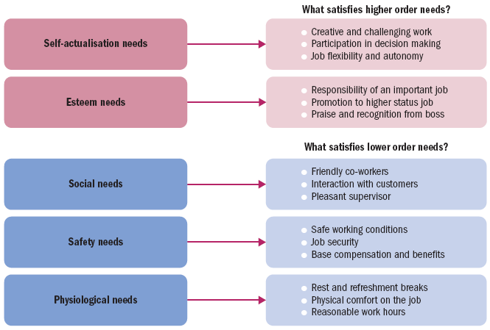
Theories of motivation
什么能满足低层次需求？
社交需求 - 友好的同事 - 与客户的互动 - 和善的上级
安全需求 - 安全的工作条件 - 工作稳定性 - 基本薪酬和福利
生理需求- 休息和放松时间 - 工作中的身体舒适感 - 合理的工作时间
什么能满足高层次需求？
自我实现需求 - 富有创造性和挑战性的工作 - 参与决策制定 - 工作灵活性和自主性
尊重需求 - 重要工作的职责 - 晋升到更高职位 - 来自老板的赞扬和认可
Notes:
Opportunities for satisfaction in Maslow’s hierarchy of human needs.

Slide 11
ERG theory ERG 理论
The existence, relatedness and growth (ERG) theory collapses Maslow’s five needs categories into three.
  Existence needs are desires for physiological and material wellbeing.
  Relatedness needs are desires for satisfying interpersonal relationships.
  Growth needs are desires for continued psychological growth and development.
Does not assume that lower level needs must be satisfied to activate higher level needs.
存在、关联和增长 （ERG） 理论将马斯洛的五个需求类别合并为三个。
存在需求是对生理和物质健康的渴望。
关联需求是满足人际关系的愿望。
成长需求是对持续心理成长和发展的渴望。
不假设必须满足较低层次的需求才能激活更高层次的需求。
Notes:
ERG theory
Existence, relatedness and growth (ERG) theory, collapses Maslow’s five needs categories into three.
Existence needs are desires for physiological and material wellbeing.
Relatedness needs are desires for satisfying interpersonal relationships.
Growth needs are desires for continued psychological growth and development.
This theory does not assume that lower level needs must be satisfied before higher level needs become activated.

Slide 12
Herzberg’s two-factor theory(motivation-hygiene theory)
赫茨伯格双因素理论（动机-卫生理论）
Satisfier factors (Motivators) are found in job content, such as a sense of achievement, recognition, responsibility, advancement and personal growth.
Hygiene factors are found in the job context, such as working conditions, interpersonal relations, organisational policies and salary.
Improving hygiene factors can make people less dissatisfied with these aspect of work, but do not in themselves increase satisfaction.
更令人满意的因素（激励因素）存在于工作内容中，例如成就感、认可、责任感、进步和个人成长。
卫生因素存在于工作环境中，例如工作条件、人际关系、组织政策和薪水。
改善卫生因素可以减少人们对工作这些方面的不满，但本身不会提高满意度。
Notes:
Hertzberg’s Two-factor theory
Satisfier factors are found in job content, such as a sense of achievement, recognition, responsibility, advancement and personal growth.
Hygiene factors are found in the job context, such as working conditions, interpersonal relations, organisational policies and salary. Hygiene factors are sources of job dissatisfaction, with aspects of job context. That is, ‘dissatisfiers’ are considered more likely to be a part of the work setting than of the nature of the work itself. Improving the hygiene factors, such as implementing a no-smoking policy, can make people less dissatisfied with these aspects of their work. But they would not in themselves contribute to increases in satisfaction.

Slide 13
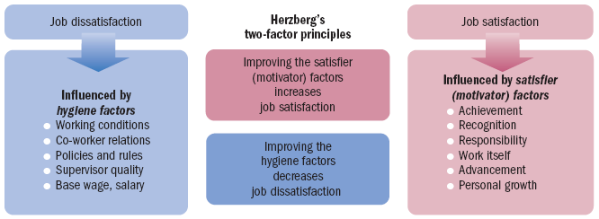
Theories of motivation
### 工作不满意
受保健因素影响
- 工作条件
- 同事关系
- 政策与规章制度
- 上级素质
- 基本工资、薪水
### 工作满意
受激励因素影响
- 成就
- 认可
- 责任
- 工作本身
- 晋升
- 个人成长
### 赫兹伯格的双因素理论
- 提升激励因素可增加工作满意度
- 改善保健因素可减少工作不满意
Notes:
As part of job content, the satisfier factors deal with what people actually do in their work.
The important satisfier factors include such things as a sense of achievement, feelings of recognition, a sense of responsibility, the opportunity for advancement and feelings of personal growth.
Herzberg’s advice to managers is still timely: always correct poor context to eliminate actual or potential sources of job dissatisfaction, and be sure to build satisfier factors into job content to maximise opportunities for job satisfaction.

Slide 14
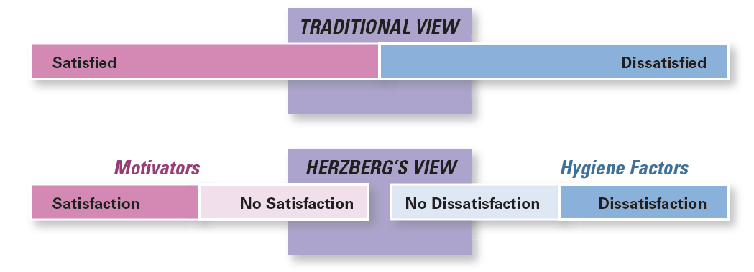
Exhibit 16-3
Contrasting Views of Satisfaction and Dissatisfaction
图表 16-3 对满意和不满意的看法截然不同
激励因素
卫生因素
As shown in Exhibit 16-3, Herzberg proposed that a dual continuum existed: The opposite of “satisfaction” is “no satisfaction,” and the opposite of “dissatisfaction” is “no dissatisfaction.”
如图表 16-3 所示，Herzberg 提出存在一个双重连续体：“满意”的反面是“不满意”，而“不满意”的反面是“没有不满意”。
Notes:
Herzberg believed the data suggested that the opposite of satisfaction was not dissatisfaction, as traditionally had been believed. Removing dissatisfying characteristics from a job would not necessarily make that job more satisfying (or motivating). As shown in Exhibit 16-3, Herzberg proposed that a dual continuum existed: The opposite of “satisfaction” is “no satisfaction,” and the opposite of “dissatisfaction” is “no dissatisfaction.”
要激励员工，不是只消除不满意的因素，而是注重激励因素

Slide 15
Acquired needs theory （McClelland’s three needs theory）获得性需求理论（麦克利兰的三需求理论）
Need for achievement (nAch) is the desire to do something better or more efficiently, to solve problems, or to master complex tasks.
Need for power (nPower) is the desire to control other people, to influence their behaviour, or to be responsible for them.
Need for affiliation (nAff) is the desire to establish and maintain friendly and warm relations with other people.
成就需求 （nAch） 是希望做得更好或更高效、解决问题或掌握复杂任务的愿望。
权力需求 （nPower） 是控制他人、影响他们的行为或对他们负责的愿望。
需要隶属关系 （nAff） 是与他人建立和维持友好和温暖关系的愿望。
Notes:
Acquired needs theory
McClelland identified three needs that are central to his approach to motivation:
Need for achievement (nAch) is the desire to do something better or more efficiently, to solve problems, or to master complex tasks.
Need for power (nPower) is the desire to control other people, to influence their behaviour, or to be responsible for them.
Need for affiliation (nAff) is the desire to establish and maintain friendly and warm relations with other people.

Slide 16
Process theories of motivation动力的过程理论
Process theories of motivation offer additional insights into how people give meaning to rewards and then respond with various work-related behaviours.
The equity, expectancy and goal-setting theories each offer advice on how people make choices to work hard or not based on:
  Individual preferences
  Available rewards
  Possible work outcomes.
动机的过程理论为人们如何赋予奖励意义，然后以各种与工作相关的行为做出反应提供了额外的见解。
公平理论、期望理论和目标设定理论都为人们如何根据以下因素选择努力工作或不努力工作提供了建议：
个人偏好
可用奖励
可能的工作结果。

Slide 17
Equity theory of motivation
动力公平理论
Equity theory states that motivation is affected by the outcomes we receive for our inputs compared to the outcomes and inputs of other people.
Perceived inequity occurs when people feel rewards for their efforts in comparison to others’ rewards are unfair. They generally deal with this by:
  changing their work inputs by putting less effort into their jobs;
  changing the rewards received by asking for better treatment;
  changing the comparison points;
  changing the situation by leaving the job.
公平理论指出，与其他人的结果和输入相比，我们的输入结果会影响动机。
当人们觉得自己的努力得到的回报与他人的回报相比是不公平的时，就会发生感知到的不公平。他们通常通过以下方式处理这个问题：
通过减少对工作投入的精力来改变他们的工作投入;
通过要求更好的待遇来改变获得的奖励;
更改比较点;
通过离职来改变情况。
Notes:
The equity theory of motivation is best known through the work of J. Stacy Adams. It is based on the logic of social comparisons and the notion that perceived inequity is a motivating state.
Perceived inequities occur whenever people feel that the rewards received for their work efforts are unfair, given the rewards others appear to be getting for their work efforts.
People will try to deal with perceived negative inequity by
changing their work inputs by putting less effort into their jobs
changing the rewards received by asking for better treatment
changing the comparison points to make things seem better
changing the situation by leaving the job.

Slide 18
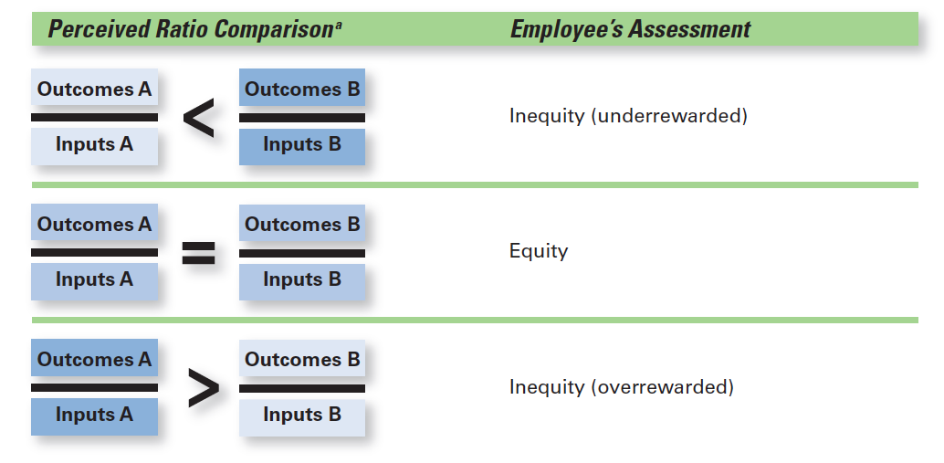
Exhibit 16-7 Equity Theory 图表 16-7 公平理论
感知比率比较
员工评估
不公平（报酬过低）
公平
Exhibit 16-5 shows the Equity Theory. 图 16-5 显示了公平理论。
不公平（报酬过高）
Notes:
Source: “Job Characteristics Model,” from Work Redesign, by J. R. Hackman & G. R. Oldham. Copyright © 1980 by Addison- Wesley (a division of Pearson). Reprinted with permission.

Slide 19
Goal-setting theory
目标设定理论
Goal-setting theory:
  Task goals can be highly motivating if they are properly set and if they are well managed.
How to Make Goal Setting Work for You
  Set specific goals
  Set challenging goals
  Build goal acceptance and commitment
  Clarify goal priorities
  Provide feedback on goal accomplishment
  Reward goal accomplishment
目标设定理论： 如果任务目标设定得当并且管理得当，它们可以非常激励人心。
如何让目标设定为您服务
设定具体目标
设定具有挑战性的目标
建立目标接受和承诺
明确目标优先级
提供有关目标完成情况的反馈
奖励目标完成
Notes:
Goal-setting theory
Goal-setting theory suggests that task goals can be highly motivating — if they are properly set and if they are well managed. Goals give direction to people in their work. Goals clarify the performance expectations between a supervisor and subordinate, between co-workers, and across subunits in an organisation.
The opportunity to receive feedback on goal accomplishment is also essential to motivation.

Slide 20
Expectancy theory of motivation动力的期望理论
Motivation to work depends on relationship between three factors.
  Expectancy: Belief that working hard will result in a desired level of task performance being achieved (effort–performance expectancy).
  Instrumentality: Belief that successful performance will be followed by rewards (performance–outcome expectancy).
  Valence: The value a person assigns to the possible rewards and other work-related outcomes.
工作动力取决于三个因素之间的关系。
期望：相信努力工作将导致达到理想的任务绩效水平（努力 - 绩效预期）。
工具性：相信成功的绩效之后会有奖励（绩效-结果预期）。
效价：一个人为可能的奖励和其他与工作相关的结果分配的价值。
Notes:
Expectancy theory
Vroom suggests that the motivation to work depends on the relationships between three expectancy factors:
Expectancy is a person’s belief that working hard will result in a desired level of task performance being achieved (this is sometimes called effort–performance expectancy).
Instrumentality is a person’s belief that successful performance will be followed by rewards and other potential outcomes (this is sometimes called performance–outcome expectancy).
Valence is the value a person assigns to the possible rewards and other work-related outcomes.

Slide 21
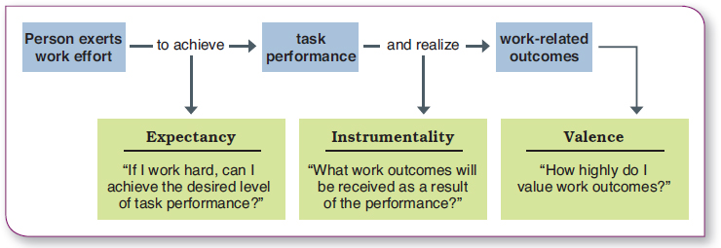
Expectancy theory of motivation动力的期望理论
人员付出工作努力 | 以达成 | 任务绩效 | 并实现 | 与工作相关的结果
 | 期望 “如果我努力工作，我能否达到期望的任务绩效水平？” |  | 工具性 “由于这种绩效，我会得到什么样的工作结果？” | 效价 “我对工作结果的重视程度如何？”
Notes:
Expectancy theory
Vroom suggests that the motivation to work depends on the relationships between three expectancy factors:
Expectancy is a person’s belief that working hard will result in a desired level of task performance being achieved (this is sometimes called effort–performance expectancy).
Instrumentality is a person’s belief that successful performance will be followed by rewards and other potential outcomes (this is sometimes called performance–outcome expectancy).
Valence is the value a person assigns to the possible rewards and other work-related outcomes.

Slide 22
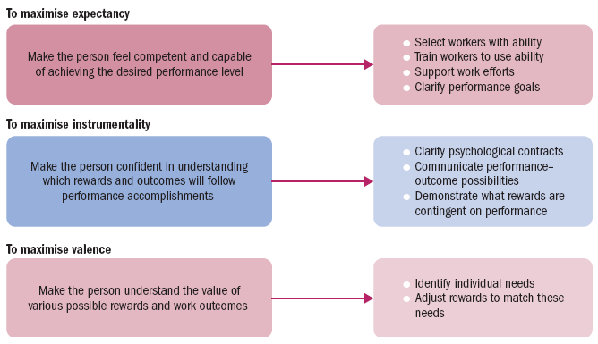
Managerial implications of expectancy theory
最大化期望
让员工相信自己有能力达到期望的绩效水平
  挑选有能力的员工
  培训员工以发挥其能力
  支持员工的工作努力
  明确绩效目标
最大化工具性
让员工确信自己明白绩效达成后会得到何种奖励和结果
  明确心理契约
  沟通绩效与可能结果的关系
  说明绩效与奖励的关联
最大化效价
让员工理解各种可能的奖励和工作成果的价值
  识别个人需求
  调整奖励以满足这些需求
Notes:
Management implications include being willing to work with each individual to maximise his or her expectancies, instrumentalities and valences in ways that support organisational objectives.
A manager should work with others to clearly link effort and performance, confirm performance–outcome relationships and reward performance with valued work outcomes.

Slide 23
Reinforcement Theory
强化理论
Reinforcement theory: the theory that behavior is a function of its consequences
Reinforcers: consequences immediately following a behavior, which increase the probability that the behavior will be repeated
强化理论：行为是其后果的函数的理论
强化物：行为之后的后果，这会增加行为重复的可能性
Notes:
比如说要想让员工为了业绩更拼，就要给提成。
goal-setting theory和reinforcement theory怎么区分。一个是强调目标本身能够激励员工，不一定有奖励；一个强调的是激励物（可能是奖励可能是惩罚）
可以通过积极强化有助于组织实现其目标的行为，同时无视不合适的行为，来激励员工。通常不要惩罚
李梦凡 回复 柴国民 ：强化理论有助于去控制和影响人们的自愿行为。但是他忽略了人的内在因素，也没有考虑目标，期望需求这些因素。而且一旦人们习惯了获得奖励，如果某种行为并没有获得奖励，这种行为重复的可能性就会降低
Reinforcement theory says that behavior is a function of its consequences. Those consequences that immediately follow a behavior and increase the probability that the behavior will be repeated are called reinforcers. Reinforcement theory ignores factors such as goals, expectations, and needs. Instead, it focuses solely on what happens to a person when he or she does something.

Slide 24
Reinforcement strategies
强化策略
Operant conditioning: The control of behaviour by manipulating its consequences (learning by reinforcement).
Organisational behaviour modification (OB Mod): The application of operant conditioning to influence human behaviour at work.
操作性条件反射：通过纵行为的后果来控制行为（通过强化学习）。
组织行为修正 （OB Mod）：应用作性条件反射来影响人类在工作中的行为。
Notes:
Reinforcement strategies
Operant conditioning is the control of behaviour by manipulating its consequences. You may think of operant conditioning as learning by reinforcement.
Organisational behaviour modification (OB Mod) is the application of operant conditioning to influence human behaviour at work.
Four strategies of reinforcement are used in operant conditioning:
Positive reinforcement strengthens a behaviour by making a desirable consequence contingent on its occurrence.
Negative reinforcement strengthens a behaviour by making the avoidance of an undesirable consequence contingent on its occurrence.
Punishment discourages a behaviour by making an unpleasant consequence contingent on its occurrence.
Extinction discourages a behaviour by making the removal of a desirable consequence contingent on its occurrence.

Slide 25
The four strategies of reinforcement
强化的四种策略
  Positive reinforcement: rewarding desired behaviors
  Negative reinforcement: removing an unpleasant consequence once the desired behavior is exhibited
  Punishment: penalizing an undesired behavior
  Extinction: eliminating a reinforcement for an undesired behavior
正强化：奖励期望的行为
负强化：一旦表现出所需的行为，就会消除令人不快的后果
惩罚：惩罚不良行为
消退：消除不良行为的加固
Notes:
Because learning takes place on the job as well as prior to it, managers are concerned with how they can teach employees to behave in ways that most benefit the organization. Thus, managers will often attempt to “mold” individuals by guiding their learning in graduated steps, through a method called shaping behavior.
Four ways to shape behavior include positive reinforcement, negative reinforcement, punishment, and extinction. When a behavior is followed by something pleasant, such as praising an employee for a job well done, it’s called positive reinforcement. Positive reinforcement increases the likelihood that the desired behavior will be repeated. Rewarding a response by eliminating or withdrawing something unpleasant
is negative reinforcement. A manager who says, “I won’t dock your pay if you start getting to work on time” is using negative reinforcement. The desired behavior (getting to work on time) is being encouraged by the withdrawal of something unpleasant (the employee’s pay being docked). On the other hand, punishment penalizes undesirable behavior and will eliminate it. Suspending an employee for two days without pay for habitually coming to work late is an example of punishment. Finally, eliminating any reinforcement that’s maintaining a behavior is called extinction. When a behavior isn’t reinforced, it gradually disappears.
行为塑造
学习不但发生于工作之前，还发生于工作之中，因而管理者应该注重如何教导员工，使他们的行为对组织最有利。管理者常常通过逐步指导个体学习的方式来塑造个体，这一过程称为行为塑造(Shaping behavior)。
Positive 最有用，punishment最反面作用
要注意员工的行为情境与管理层的追求相差极大。如果管理层仅当个体表现出理想的反应时才强化个体，则可能几乎无处强化。在这种情况下，行为塑造提供了一种获得理想的行为的可行做法。
行为塑造通过系统地强化每一连续步骤而使个体越来越趋近理想的反应。对于一名长期迟到半小时上班的员工，如果他此次上班迟到了20分钟，我们就应强化这种进步。当反应越来越接近理想行为时，强化也应不断提高。
行为塑造的四种方法：积极强化、消极强化、惩罚和忽视。
当一种反应伴随着愉快事件时，如管理者称赞员工工作干得好，称之为积极强化。
当中止或逃避不愉快事件的反应获得奖励时，称之为消极强化。常常责备下属中间休息时间过长的管理者使用的就是消极反馈。这些下属唯一能停止责备的办法就是缩短中间休息时间。
惩罚指对令人不满的行为进行处罚。员工因为酗酒问题而被责令停工两天不付薪金就是惩罚的一个例子。
消除任何维持行为的强化物的办法则称为忽视。当行为不被强化时，便倾向于逐渐消失。在开会时，如果管理者不希望下属不属不停地提出干扰或无关问题，则可以消除这些活动，即当这些员工举手要发言时，无视他们的存在，那举手行为必然得不到强化，这种行为便会消失。
积极强化和消极强化都导致了学习。他们强化了理想的反应，增加了其重复的可能性。惩罚和忽视也导致了学习，但它们是削弱了行为，并减少了其发生的频率。

Slide 26
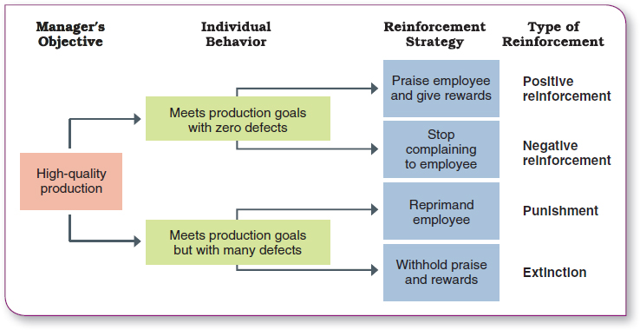
The four strategies of reinforcement 强化的四种策略
管理者目标 | 个人行为 | 强化策略 | 强化类型
高质量生产 | 达成生产目标且零缺陷 | 表扬员工并给予奖励 | 正强化
 |  | 停止对员工抱怨 | 负强化
 | 达成生产目标但存在大量缺陷 | 斥责员工 | 惩罚
 |  | 不给予表扬和奖励 | 消退

Slide 27
Reinforcement theory of motivation
动力强化理论
The law of effect
  Behaviour that results in a pleasant outcome is likely to be repeated; behaviour that results in an unpleasant outcome is not likely to be repeated.
  Positive reinforcement should be a central part of a manager’s motivating strategy.
    Law of contingent reinforcement
      A reward must be delivered only if the desired behaviour is exhibited.
    Law of immediate reinforcement
      The more immediate the delivery of a reward the greater the reinforcing value of the reward.
效果定律
导致愉快结果的行为可能会重复;导致不愉快结果的行为不太可能重复。
积极强化应该是管理者激励策略的核心部分。
或有强化法则
只有在表现出期望的行为时，才能提供奖励。
立即强化法则 奖励的交付越迅速，奖励的强化价值就越大。
Notes:
Reinforcement theory of motivation
Reinforcement theory views human behaviour as determined by its environmental consequences. Instead of looking within the individual to explain motivation and behaviour, it focuses on the external environment and the consequences it holds for the individual.
The basic premises of the theory are based on what E. L. Thorndike called the law of effect — behaviour that results in a pleasant outcome is likely to be repeated; behaviour that results in an unpleasant outcome is not likely to be repeated.

Slide 28
Designing Motivating Jobs (1 of 2)
设计激励性工作 （1/2）
Job design: the way tasks are combined to form complete jobs
Job scope: the number of different tasks required in a job and the frequency with which those tasks are repeated
Job depth: the degree of control employees have over their work
Job enlargement: the horizontal expansion of a job by increasing job scope
Job enrichment: the vertical expansion of a job by adding planning and evaluating responsibilities
工作设计：将任务组合成完整作业的方式
工作范围：工作中所需的不同任务的数量以及这些任务的重复频率
工作深度：员工对其工作的控制程度
工作扩大：通过扩大工作范围来横向扩展工作
工作充实：通过添加规划和评估职责来垂直扩展工作
Notes:
Because managers want to motivate individuals on the job, we need to look at ways to design motivating jobs. We use the term job design to refer to the way tasks are combined to form complete jobs. The jobs people perform in an organization should not evolve by chance. Managers should design jobs deliberately and thoughtfully to reflect the demands of the changing environment; the organization’s technology; and employees’ skills, abilities, and preferences.
An early effort at overcoming the drawbacks of job specialization involved horizontally expanding a job through increasing job scope—the number of different tasks required in a job and the frequency with which these tasks are repeated. For instance, a dental hygienist’s job could be enlarged so that in addition to cleaning teeth, he or she is pulling patients’ files, refiling them when finished, and sanitizing and storing instruments. This type of job design option is called job enlargement.

Slide 29
Designing Motivating Jobs (2 of 2)
设计激励性工作 （2/2）
Job characteristics model (JCM): a framework for analyzing and designing jobs that identifies five primary core job dimensions, their interrelationships, and their impact on outcomes
工作特征模型 （JCM）：一个用于分析和设计工作的框架，用于确定五个主要的核心工作维度、它们的相互关系及其对结果的影响
Notes:
Another approach to job design is the vertical expansion of a job by adding planning and evaluating responsibilities—job enrichment. Job enrichment increases job depth, which is the degree of control employees have over their work. In other words, employees are empowered to assume some of the tasks typically done by their managers. Thus, an enriched job allows workers to do an entire activity with increased freedom, independence, and responsibility.
Even though many organizations implemented job enlargement and job enrichment programs and experienced mixed results, neither
approach provided an effective framework for managers to design motivating jobs. But the job characteristics model (JCM) does. It identifies five core job dimensions, their interrelationships, and their impact on employee productivity, motivation, and satisfaction.

Slide 30
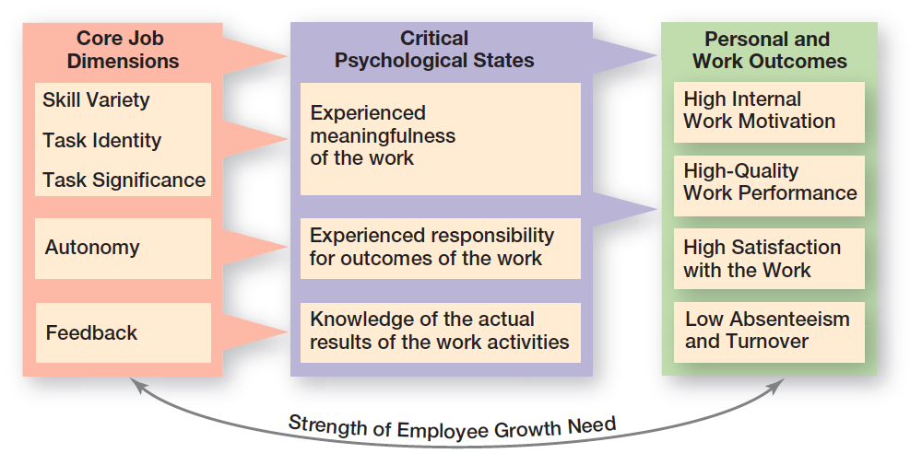
Exhibit 16-6 Job Characteristics Model
图表 16-6 工作特征模型
核心工作维度 | 关键心理状态 | 个人及工作成果
技能多样性 任务完整性 任务重要性 自主性 反馈 | 体验到工作的意义 体验到对工作成果的责任感 了解工作活动的实际结果 | 高内在工作动机 高质量工作绩效 高工作满意度 低缺勤率和离职率
 | 员工成长需求强度
Notes:
Source: “Job Characteristics Model,” from Work Redesign, by J. R. Hackman & G. R. Oldham. Copyright © 1980 by Addison- Wesley (a division of Pearson). Reprinted with permission.

Slide 31
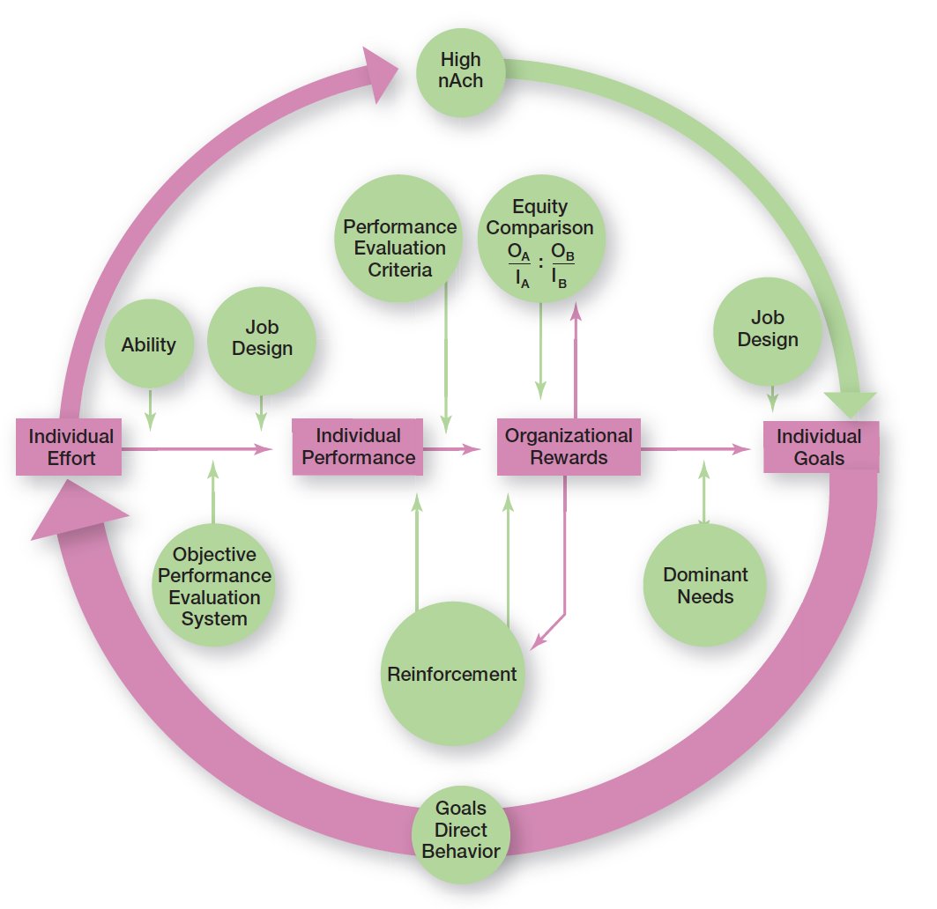
Exhibit 16-9 Integrating Contemporary Theories of Motivation 图表 16-9 整合当代动机理论
高成就需要
公平比较
绩效评估标准
工作设计
工作设计
能力
个人努力
个人绩效
组织奖励
个人目标
客观绩效评估系统
主导需求
强化
目标导向行为
Notes:
Many of the ideas underlying the contemporary motivation theories are complementary, and you’ll understand better how to motivate people if you see how the theories fit together. Exhibit 16-9 presents a model that integrates much of what we know about motivation. Its basic foundation is the expectancy model. Let’s work through the model, starting on the left.
The individual effort box has an arrow leading into it. This arrow flows from the individual’s goals. Consistent with goal-setting theory, this goals–effort link is meant to illustrate that goals direct behavior. Expectancy theory predicts that an employee will exert a high level of effort if he or she perceives a strong relationship between effort and performance, performance and rewards, and rewards and satisfaction of personal goals. Each of these relationships is in turn influenced by certain factors. You can see from the model that the level of individual performance is determined not only by the level of individual effort but also by the individual’s ability to perform and by whether the organization has a fair and objective performance evaluation system. The performance–reward relationship will be strong if the individual perceives that performance (rather than seniority, personal favorites, or some other criterion) is what is rewarded. The final link in expectancy theory is the rewards–goal relationship. The traditional need theories come into play at this point. Motivation would be high to the degree that the rewards an individual received for his or her high performance satisfied the dominant needs consistent with his or her individual goals.

